Slide 1


RootsPlus
Where Code Meets Cultivation
Solo Project - AXSOS Academy - 2025

Slide 2
About Idea
RootsPlus is a proposed concept for an agricultural technology company dedicated to transforming the way farming works. It aims to bridge the gap between farmers and agronomists by providing smart tools, actionable insights, and a supportive ecosystem that helps agriculture thrive.
Its mission is to make farming smarter, more sustainable, and more profitable by connecting expert knowledge with real-world agricultural needs.

Slide 3
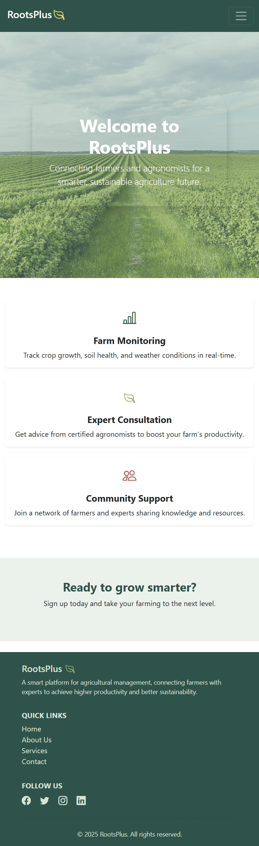
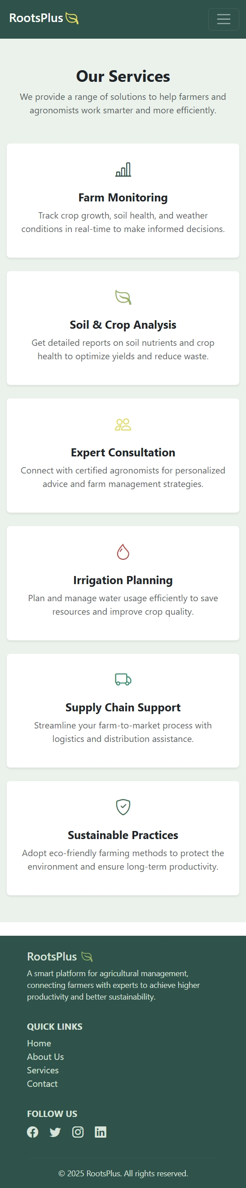
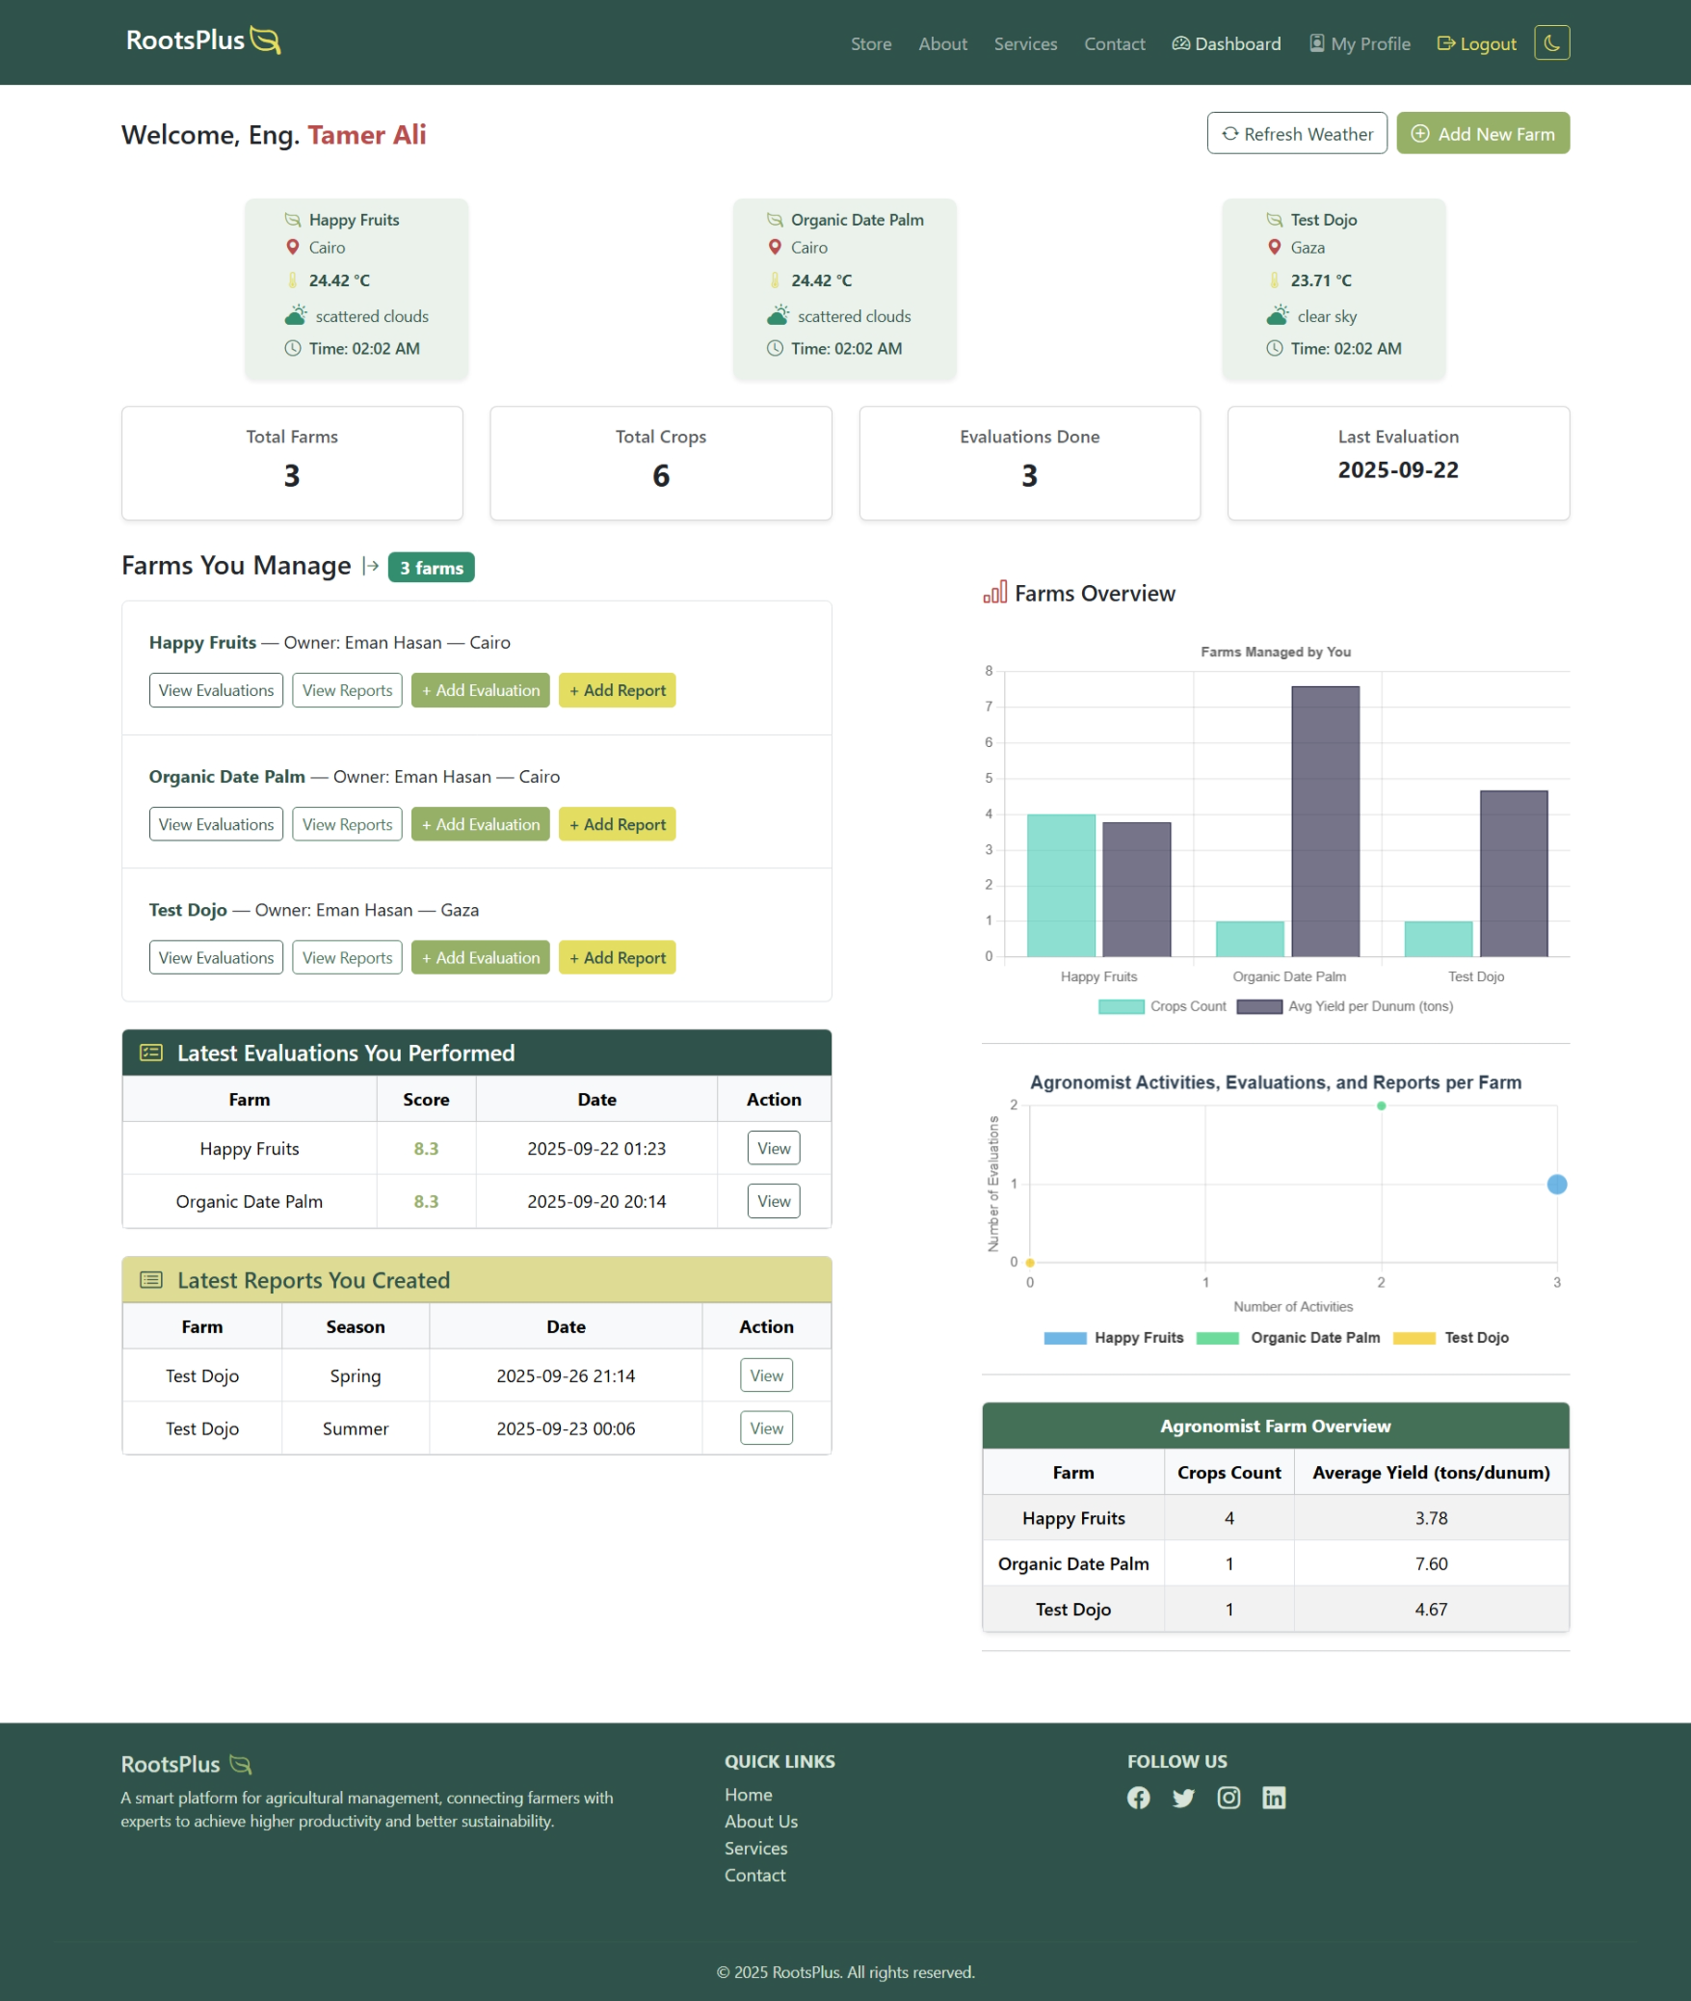
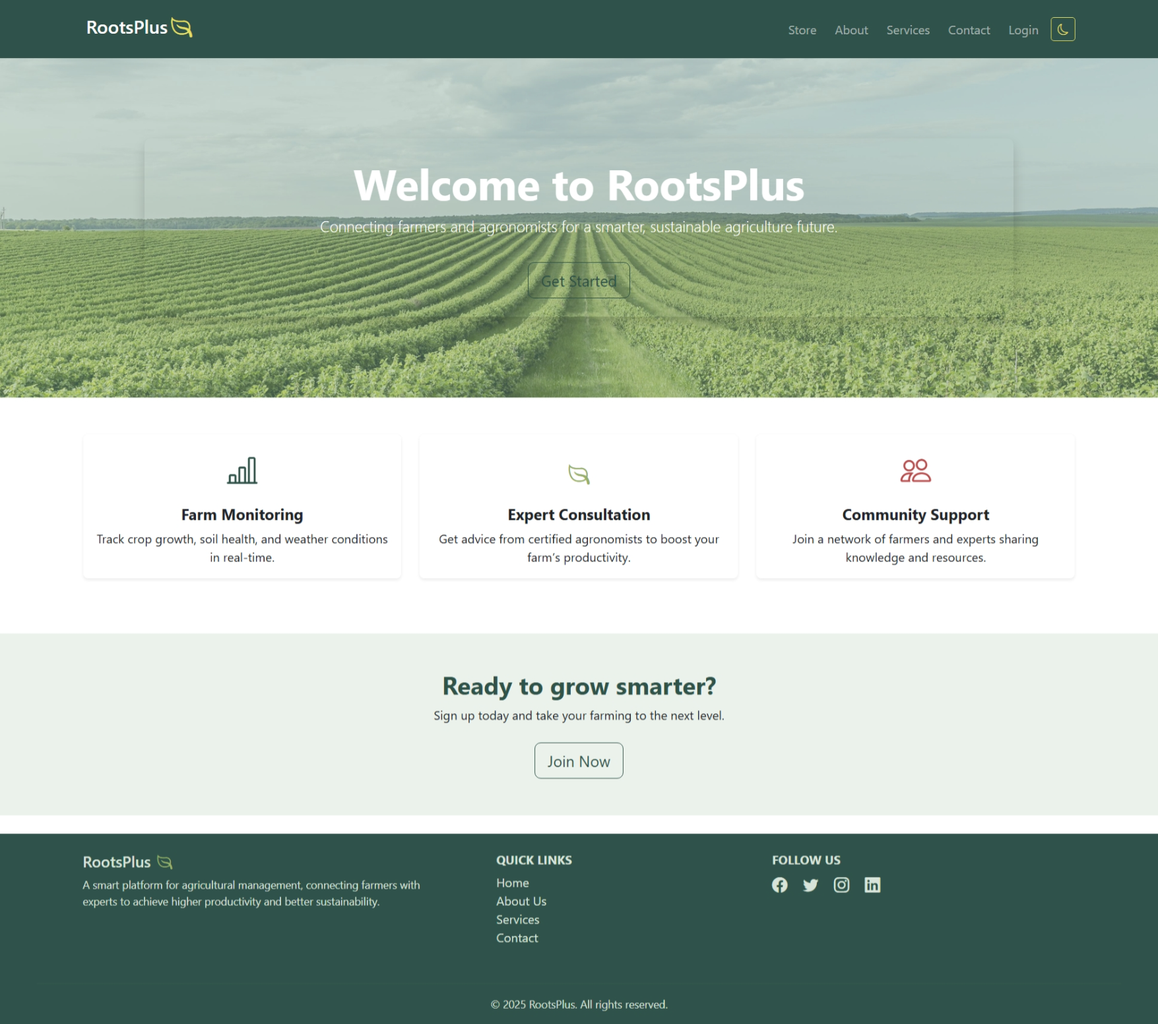
Adaptive & Responsive Layout

Slide 4

Project Overview
The project is composed of four interconnected applications, each serving a distinct role
3. Admin Panel App
- Centralized dashboard for administrators.
- Aggregates farms, users, engineers, activities, evaluations, and reports.
1. Login & Register App
- Handles user registration and authentication.
- Manages sessions, roles, and secure access.
Main Color Palette
2. Public App
- The public-facing website.
- Provides general information and services to visitors.
4. Roots Plus App
- The core application for farmers and agronomists.
- Supports farm management, evaluations, reports, and crop tracking.
- Enhances collaboration between farmers and agronomists.

Slide 5
Key Features
Role-Based Dashboards Tailored interfaces for farmers, agronomists, and administrators.
Smart Farm Monitoring Real-time tracking of farm activities, evaluations, and reports.
User-Friendly Design Clean, responsive UI built for clarity and warmth across all devices.
Secure Access & Permissions Robust session management and role-based access control. Passwords are securely hashed using bcrypt to ensure user data protection.
Animated Counters & Visuals Engaging dashboard elements powered by Bootstrap and Chart.js.
Scalable Architecture Built with Django and MySQL for modular growth and future expansion.

Slide 6







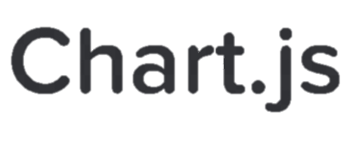
Technologies Used
Backend
Frontend
APIs & Integrations
Bootstrap 5
AJAX
Chart.js
Django (Python)
MySQL
OpenWeather API
CSV Export (Python csv module)

Slide 7

What Next ?
Future Outlook
Launching a technical blog to foster communication between
agronomists and farmers.
Build a dedicated app for agronomists and another for farmers.
Enabling interactive image embedding within reports and evaluations
Adding advanced statistics to support smarter decision-making

Slide 8
Links
GitHub Repo: MohDDH/rootsPlus
AWS

Slide 9
Acknowledgement
Special thanks to AXSOS Academy for giving us this valuable opportunity, and heartfelt appreciation to Eng. Mohammad Essa, Eng. Fatima Harahsheh, and Eng. Shahd Fakhouri their guidance, support, and dedicated efforts.

